Slide 1


Slide 2


Samuel
Khiela

Slide 3


Samuel
Khiela

Slide 4


Samuel
Khiela

Slide 5


Slide 6


Slide 7
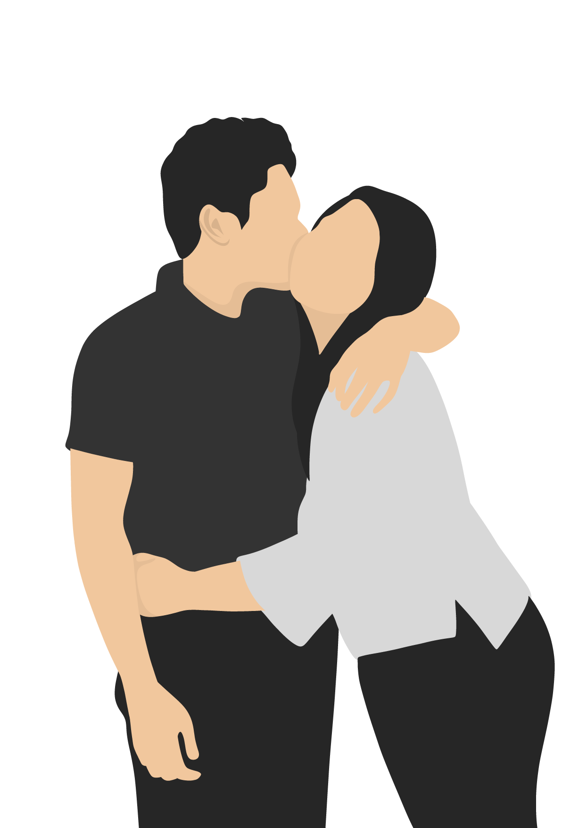

Slide 8


Slide 9


Slide 10


Slide 11

Samuel
Khiela

Slide 12

Samuel
Khiela

Slide 13




53
230
1620
38690
months
weeks
days
hours
and still counting …

Slide 14






Places we went together:
Places we eat together:
Pinto Art Museum
Manila Ocean Park
Quezon City Memorial Circle
Club Manila East
The Dessert Museum
Palaya Natural Farm
Bluebay Walk
Bosay Resort
Tales of Illumina
Azure Urban Residences Resort
Blue Magic
Datablitz
Surplus
Vape Barracks
Xundd Philippines
Taytay Tiangge
SM Megamall
SM Mall of Asia
SM Fairview
SM North EDSA
SM East Ortigas
SM Masinag
SM Bicutan
Gateway Mall
Farmer’s Market
Robinsons Metro East
Sta. Lucia Mall
WalterMart Antipolo
Fisher Mall
Sambokojin
Samgyupsalamat
Marugame Udon
Tokyo Tokyo
Genki Sushi
Tipsy Porky
Buffet 199
Saram Korean BBQ Grill Buffet
S&R New York Style Pizza
Mcdonald’s
Zark’s Burger
Burger King
Jill & Pops
KFC
Route 88 Bike Café
Mang Inasal
Kuya J’s Restaurant
Hepalog
Dairy Queen
Infinitea
I Love Milktea
Chatime
Moonleaf Tea Shop
Café Lupe Antipolo
Chachago

Slide 16
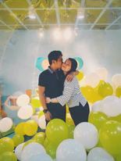

Slide 17
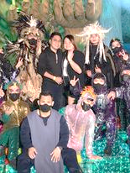

Slide 18



Samuel
Khiela

Slide 20


"As long as we share the same sky and
breathe the same air, we're still together."
- Donna Lynn Hope

Slide 21
"As long as we share the same sky and
breathe the same air, we're still together."
- Donna Lynn Hope

Slide 22
"We keep this love in a photograph. We made these memories
for ourselves; where our eyes are never closing, hearts are never broken,
and time's forever frozen, still."
- Photograph (2014) by Ed Sheeran

Slide 24


